Slide 1
Perception of Usability in Video Games
Ryan Pritchard

Slide 2
Usability: What is it?
Defined by ISO 9241-11, 1998 (Guidance on usability): “The extent to which a product can be used by specified users to achieve specified goals with effectiveness, efficiency, and satisfaction in a specified context of use.”
That is, user-friendliness.
In the context of video games, ‘satisfaction’ is more important than effectiveness or efficiency.

Slide 3
Contributions
Barnett, Gatzidis and Harvey.
Guidance (tutorials in or out of game) can aid usability, but intuitive design has a direct correlation with usability.
Validated their results using an adapted IBM Post-Study System Usability Questionnaire to interview the participants in the experiment.
Using two different games gave insight into cross-genre correlations.

Slide 4
Reproducing Results overview
Define the aspects of usability that are relevant to the experiment.
Utilize Super Mario Run and Linia.
Run the experiment identically, with a smaller sample size.
Interview participants using the modified IBM PSSUQ(Post-Study System Usability Questionnaire) outlined in the original paper.
Draw conclusions from the overall results of the questionnaire.

Slide 5
Methodology
Divide participants randomly into control/treatment group.
Treatment group: explained the rules at start of test.
Control group: no guidance.
What users know/don’t know going into survey…

Slide 6
Methodology, cont.
Choose the first game randomly (Linia or SMR)
Users played first game for 60 seconds.
User fills out IBM PSSUQ #1.
Users played second game for 60 seconds.
User fills out IBM PSSUQ #2.
Sample size: 6, from 20

Slide 7
IBM Post-Study System Usability Questionnaire
Questioned over a 7-point Likert scale
Overall, I am satisfied with how easy it is to play this game.
It was simple to play this game.
I could effectively complete the objectives and challenges.
I was able to complete objectives and challenges quickly.
I was able to efficiently complete objectives and challenges.
I felt comfortable using this system.
It was easy to learn to play this game.
Whenever I make a mistake in the game, I recover easily and quickly.
The organization of information on the game screen is clear.
The interface of this game is pleasant.
I like using the interface of this game.

Slide 8
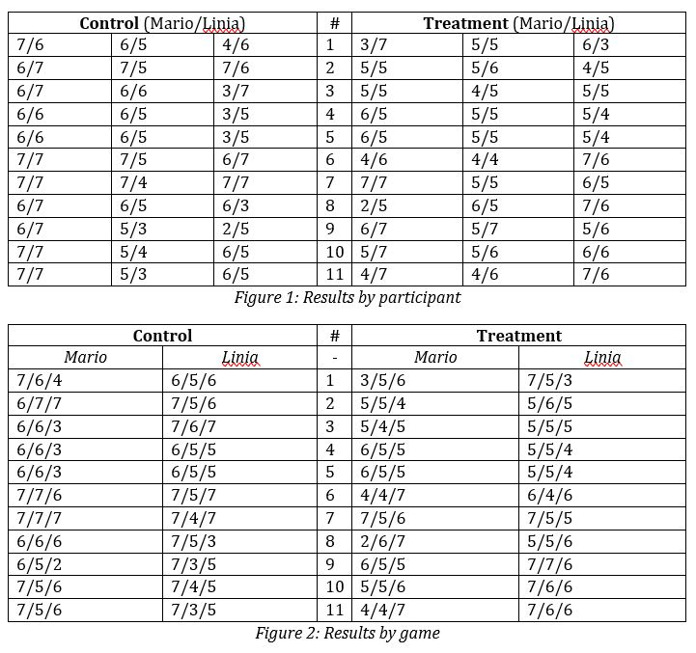
Results

Slide 9
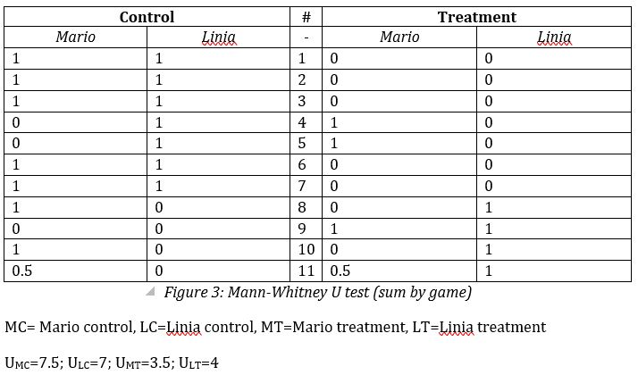
Results, cont.
Mann-Whitney U test: Win=1, Tie = 0.5

Slide 10
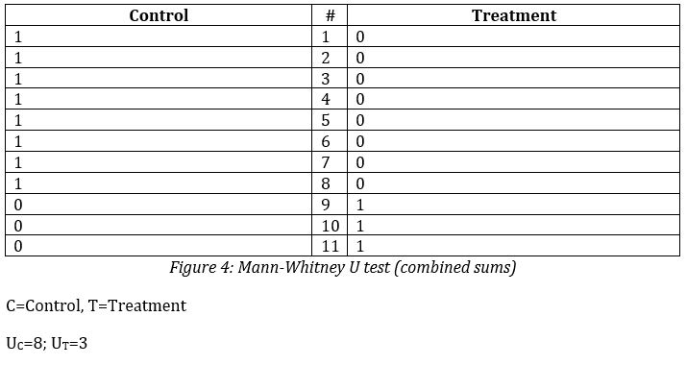
Results, cont.
Mann-Whitney U test: Win=1, Tie = 0.5

Slide 11
Discussion
Significant correlation between satisfaction and lack of guidance.
Slight edge to Super Mario Run over Linia when compared separately.
Even ‘wins’ in Treatment were still close, while Control had some blowouts.
Corroborates conclusions drawn by Barnett, Gatzidis and Harvey.

Slide 12
Points of Contention
Sample size.
6 is paltry, 20 isn’t much better.
Scale of audience unclear.
Problematic outliers.
Possibly just luck that kept results consistent.

Slide 13
Conclusion
Sound experiment (IBM PSSUQ, Mann-Whitney test) sample size notwithstanding.
Perception of usability vs guidance.

Slide 14
Citations
Barnett, L., Gatzidis, C. and Harvey, C., 2017. An Investigation into Usability and First Time User Experiences within Mobile Games. In: Edutainment, 26-28 June 2017, Bournemouth. England.
ISO 9241-11, 1998. Ergonomic requirements for office work with visual display terminals (VDTs) - Part 11: Guidance on usability. ISO.
Lewis, R.J., 1995. IBM Computer Usability Satisfaction Questionnaires: Psychometric Evaluation and Instructions for Use. Boca Raton, FL: IBM Human Factors Group. 8

